Slide 1

Maidenhill School
Knowledge Organiser
Year 10 – Term 6
Be kind, Aspire, Persevere, Achieve
Name: Tutor: 10

Slide 2

Planner - Term 6
Week 1 | Notes
Monday 2nd June
Tuesday 3rd June
Wednesday 4th June
Thursday 5th June
Friday 6th June
Week 2 | Notes
Monday 9th June | RP3 publish French speaking exams
Tuesday 10th June
Wednesday 11th June | French speaking exams
Thursday 12th June | French speaking exams
Friday 13th June
Week 1 | Notes
Monday 16th June
Tuesday 17th June
Wednesday 18th June
Thursday 19th June | Invitational Parents’ Evening 4-6.30pm
Friday 20th June | INSET DAY
Week 2 | Notes
Monday 23rd June | Work Experience Week
Tuesday 24th June
Wednesday 25th June
Thursday 26th June
Friday 27th June
Planner – Term 6

Slide 3
Planner - Term 6
Week 1 | Notes
Monday 30th June
Tuesday 1st July | Stroud College Taster Day
Wednesday 2nd July | Sports Day
Thursday 3rd July | Geography Field Trip
Friday 4th July | Geography Field Trip
Week 2 | Notes
Monday 7th July
Tuesday 8th July | School Production Cirencester College Taster Day
Wednesday 9th July | School Production
Thursday 10th July | School Production
Friday 11th July | School Production
Week 1 | Notes
Monday 14th July | Activities Week
Tuesday 15th July
Wednesday 16th July
Thursday 17th July
Friday 18th July
Planner – Term 6
Notes…

Slide 4
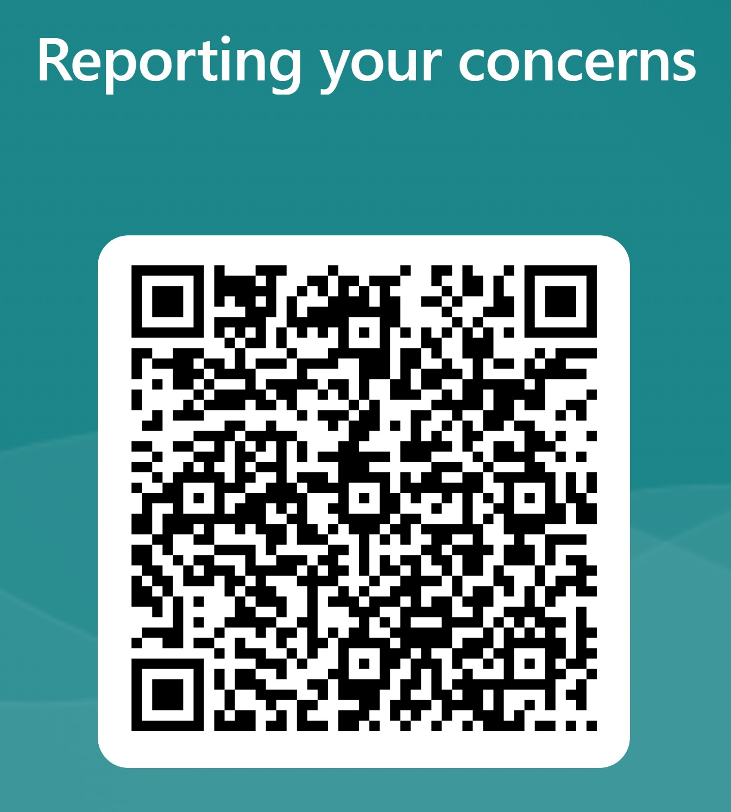
Self-certification / Out of lessons
Self-certification
Student out of lesson record
Every student is entitled to self-certify to go to the toilet on 2 occasions each term, when they do not have a medical exemption (issued by school only, in conjunction with parents). This will equate to 12 opportunities a year.
Sign below and show to your teacher. If you have a reason that requires this page to be refreshed before the end of term, please speak to your Head of Year.
Date and time | Reason | Staff signature
Date | Time | Student signature
Self-certification / Out of lessons
Insert medical exemption here (Head of Year)
Review/end date:
Have a problem? Worried about someone or something? Need someone to talk to? Scan the QR code and let us know.

Slide 5
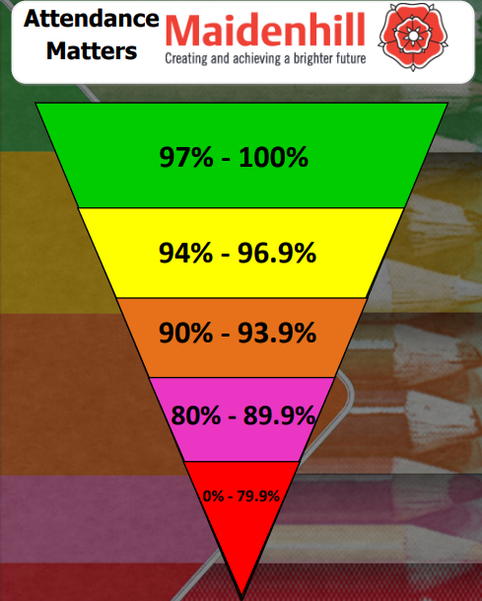
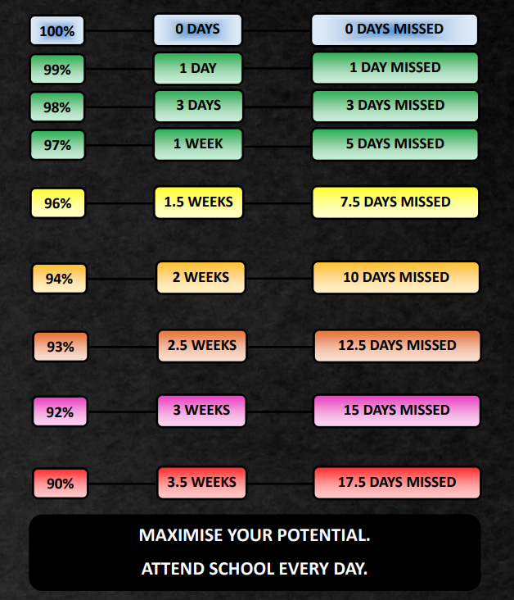
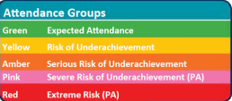
Attendance
Personal Attendance Record
Attendance – Term 6
Week | Monday | Tuesday | Wednesday | Thursday | Friday | % | Colour
1
2
3
4
5
6
7

Slide 6
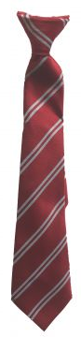
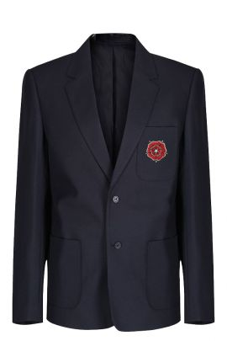

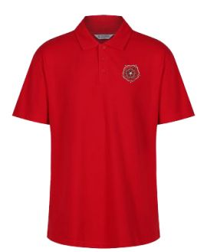
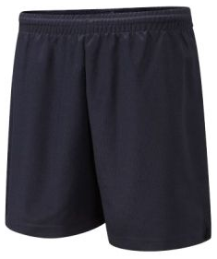

Home School Agreement and uniform expectations
As a student of the school I will:
Attend school every day and on time
Represent the school in a positive way on my way to and from school
Wear the correct school uniform smartly at all times
Ensure I have downloaded the ClassCharts app and actively use the platform so that I am up to date with notifications regarding my behaviour, attendance, homework and detentions
Follow the “Maidenhill Expectations” for all students regarding their Behaviour for Learning and uphold the school’s expectations to ‘Be kind, Aspire, Persevere and Achieve’
Not use my mobile phone in school
Go to reception if I need to contact home
Be polite and considerate to all members of the school community
Ensure that my behaviour has a positive impact on other students’ learning and progress
Refuse to take part in bullying or anti-social behaviour, including on social media
Take responsibility for my own learning and actively participate in lessons
Actively seek ways to improve my work and respond effectively to feedback
Complete all my classwork and homework to the best of my ability and on time
Respect the environment of the school and its neighbourhood, and help to keep it clean and tidy, free from litter and graffiti
Represent the school in a positive way in the local community and when participating in school activities or visits, and on social media
Talk with my parent(s)/carer(s) and school staff about any concerns in school
Pass any written correspondence to my parents’/carers’ on the day they are issued
Interact positively with any school social media platforms.
Student Signature …………………………………………………………
Maidenhill Uniform
Maidenhill school blazer needed at all times
Maidenhill school tie
Long or short sleeved plain white shirt, tucked in when in the school building
Plain black, smart, tailored trousers
Footwear should be a shoe and not a boot, and entirely black
White, grey or black socks with no logos
Black or nude tights. No patterns.
Optional
  Maidenhill skirt
  Maidenhill shorts
  Simple black belt
  Maidenhill jumper
Jewellery must be easily removed for practical lessons. Earrings must be studs and not dangle. Necklaces should be underneath the shirt
Make-up should be discreet
Hair must not be of extreme style or colour. Long hair should be tied back for health and safety reasons in certain subjects
Maidenhill PE Uniform
Red Maidenhill PE polo shirt
Red Maidenhill hooded jumper
Optional Rugby shirt
Options for the lower half:
  Plain black shorts with no logos
  Black tracksuit bottoms with no logos
  Maidenhill leggings
  Maidenhill Skort
  Plain black leggings with no logos
Home School Agreement and Uniform
Socks
  White or black
  Red needed for all fixtures
Shoes
  Suitable trainers
  Optional studded boots for football/rugby
Borrowed uniform items
Date | Item | Number | Returned

Slide 7

Equipment and acceptable use of the school ICT facilities
Equipment
You should be fully equipped for every lesson. Make sure you have the correct books for each lesson. It is always a good idea to pack your school bag the night before. Remember to check you timetable first. Here is a useful checklist.
Essential requirements
At least 2 black pens
2 pencils and 2 x 2b or 4b pencils for Art, Design and Nutrition
Ruler
Rubber
Pencil Sharpener
Scientific calculator
Colouring pencils and/or colouring pens
Headphones for music
PE kit to be worn on days with PE or dance
Student property
You are expected to have your clothing marked with your name and, wherever possible, all other items of property which you are expected to bring to school with you such as bags, pencil cases and PE kit named too.
Money, bus passes and other similar items of value should always be carried with you and never left in bags around the school at break and lunchtimes.
You have the opportunity, if you wish, to hand valuables to a teacher before PE and arrangements will be made for safe keeping. The changing rooms are not always locked during lessons. If you do not do this, the school cannot guarantee full security for your property.
Network rules
Never share your password with anyone – not even your best friend – if you suspect that someone knows it, change it or see an ICT technician as soon as possible
Never share your user area with anyone – email files to a friend or home as an attachment, or use Office 365 “One Drive”
Always log off before leaving a computer
Never tamper with ICT equipment, if your PC or laptop is damaged or not working properly, please inform a member of staff immediately. DO NOT disconnect, reconnect or move or swap any cables at any time
Never give a stranger any information about you or your home
Always communicate with strangers politely – ask a teacher to check before sending
Don’t suffer bullying – report and give a printout of any email or other material that offends you to a teacher
Avoid the spreading of computer viruses – from the internet or home. Keep your home virus checking software up to date
Do not attempt to download or install software – use only the software provided
Always give credit for information obtained from the internet
Do not eat or drink close to electronic equipment or in any computer room
Use your printing credits with care – extra print credits in any one week can only be obtained through the permission of a teacher whose work you need to print
The use of the internet at school must be in support of learning. The use of all chat systems is strictly forbidden. Inappropriate use will result in access being withdrawn. A log of all internet access and activity is monitored throughout the day by the network staff so misuse of the system can be quickly identified and dealt with.
Equipment and ICT
To access email from home, log on rmunify.com. School emails should only be used to communicate with staff/students about school related matters. You can also speak with staff via the message function on ClassCharts.
Visit the website ‘thinkyouknow’ for essential and excellent advice on using the internet safely outside of school.

Slide 8

Behaviour for Learning
At Maidenhill School we believe that students have the right to learn, and teachers have the right to teach.
When you make good choices and follow the rules, you will be rewarded.
Rewards
You can collect positive reward points in lessons and for completing quality homework. Rewards can be spent in the reward shop at the end of each term on vouchers, chocolate, stationery and much more! We have end of term rewards and end of year rewards in the form of our activities week, all to recognise the positivity and hard work you show each and every day.
If you make poor choices and do not follow the rules, then a clear set of consequences will follow.
Consequences
C2 – This is a verbal warning
C3 – Issued with a BFL detention of 40mins
C3r – This is when you are sent out of a lesson, and you must move to the referral room. You will be issued with a 55mins detention. Those students that are removed from lesson five times in a term, will then receive a 1 day internal isolation in the refocus room for every subsequent C3r. This will be reset at the start of the next term
C4 – Isolation in the refocus room
C4e – Educated off site at an alternative provision
C5 – Fixed term suspension
C5 Exclusions
If a student receives a C5 they will be excluded from school for a fixed period of time.
Incidents for which a students may be excluded include:
In possession, under the influence of or dealing in illegal drugs. This also extends to alcohol and other toxic substances
Serious physical or verbal aggression towards others
Serious rudeness, defiance, threatening behaviour or inappropriate language towards a member of the school staff
Anti-social behaviour such as theft or damage to property
A build-up of incidents which are unacceptable and contravene school standards
Repeated disruption and defiance which has disturbed the learning of other students
Persistent poor behaviour
If a student persistently behaves in an unacceptable manner, this could lead to a permanent exclusion.
In exceptional circumstances, it is appropriate for the Headteacher to permanently exclude a student for a first offence. These might include such things as:
Serious actual or threatened violence against another individual
Sexual abuse or assault
Supplying an illegal drug
Carrying an offensive weapon
The school can take no responsibility for valuable items brought into school by students (so students are advised not to bring in expensive items).
If you bring a mobile phone into school it should be switched off and kept in your bag. Under no circumstances should mobile phones be used to take images of staff or students. Consequences will be issued if a phone is seen or heard while on school site.
Behaviour for Learning
Tippex or other correcting fluids
Aerosols
Illegal substances
Energy/fizzy drinks
The following items are not allowed to be brought into school:
Alcohol and drugs
Knives and other weapons
Fireworks
Cigarettes/e-cigarettes, vapes, tobacco, matches and lighters
Smoking is not permitted in school or on the way to and from school. Students found to be smoking/vaping or in possession of smoking/vaping equipment will receive a significant sanction.
Be kind, Aspire, Persevere, Achieve

Slide 9

Bullying
What is bullying?
Bullying is when one person or a group of people deliberately hurt, threaten or frighten someone over a period of time. It can be physical; like punching or kicking, or emotional like teasing or calling names.
            Bullying includes repeated:
            Hitting
            Insults
            Cruel nicknames
            Making threats
            Isolating someone
            Damaging, taking or hiding property
            Writing or telling lies about someone
            Sending cruel text messages, video messages or emails
            Spreading rumours
            Being unfriendly and turning others against someone
            Posting inappropriate comments on websites and social media
If you are being bullied, do not suffer in silence:
Be firm – look the bully in the eye and tell them to stop
Get away from the situation as quickly as possible
Tell an adult, peer or friend what has happened, straight away
If you are scared to tell someone, get a friend to go with you
Keep on speaking up until someone listens
Don’t blame yourself for what has happened
If you are being bullied, you can expect that:
You will be listened to and taken seriously
Action will be taken to help stop the bullying
You will be involved in the process of deciding what action to take to stop the bullying and any worries that you may have will be listened to and respected
You will be given the opportunity to talk about the way that the bullying has made you feel and to find strategies to deal with these feelings and to understand and cope with bullying behaviour
If you are ever in fear of your physical safety, staff will take immediate action to keep you safe
ALL REPORTED INCIDENTS WILL BE TAKEN SERIOUSLY, INVESTIGATED AND APPROPRIATE ACTION TAKEN
Types
Physical
Cyber
Verbal
Emotional
Prejudice based
When you are talking about bullying, be clear about:
When it started
What has happened to you
How often it has happened
Who was involved
Who saw what was happening
Where and when it happened
What you have already done about it
Bullying

Slide 10
Review Point 3
 | Attitude to Learning | Attitude to homework | Organisation
Outstanding because student… | …always engages with activities showing resilience when challenged …actively seeks ways to improve work and responds effectively to feedback …demonstrates consistently high levels of effort and focus | …always demonstrates high levels of determination and motivation …works hard to proof read IS for spelling, punctuation and grammar (SPAG) …shows great pride in their presentation of homework | …is always on time to lessons and enters the classroom ready to learn …always brings correct equipment … always meets deadlines and is well prepared for tests, assessments and exams
Good because student… | …engages with activities often showing resilience when challenged …improves their work by responding to feedback …demonstrates high levels of effort and focus | …often demonstrates determination and motivation …proof reads IS for spelling, punctuation and grammar (SPAG) …shows pride in their presentation of homework | …is on time to lessons and enters the classroom ready to learn …brings the correct equipment …meets deadlines and is prepared for tests and exams
Not yet good because student… | …sometimes engages with learning activities but can be passive …responds to feedback but doesn’t always work hard enough at this …sometimes demonstrates high levels of effort and but not consistently | …sometimes demonstrates determination but sometimes effort is below expectation …checks IS for spelling, punctuation and grammar (SPAG) but could put more effort into this …could take more pride in their presentation of homework | …does not always arrive on time and/or is not always ready to learn. …sometimes forgets to bring the correct equipment for learning …sometimes does not meet deadlines and/or is not prepared for tests and exams
Urgent improvement required because student… | …rarely engages with learning activities but not at the standard expected …rarely improves their work by responding to feedback and doesn’t put enough effort into this …can make poor choices regarding behaviour and/or disrupts the learning of others | …rarely demonstrates determination and effort is often below expectation …makes insufficient effort to proof read for spelling, punctuation and grammar (SPAG) …rarely takes pride in their presentation of homework | …is often late to lessons and/or often enters the classroom not ready to learn … often lacks the correct equipment …often misses deadlines and/or is often unprepared for tests and exams
X | Teacher is unable to comment due to student absence. | Teacher is unable to comment due to student absence. | Teacher is unable to comment due to student absence.
Review Point 3

Slide 11
Review Point 3
Subject | Attitude to Learning | Attitude to Homework | Organisation | Y11 MEG | Predicted Grade
English language
English literature
Maths
Reflections
What Went Well – what have you made progress in?
1. …………………………………………………………………………….
………………………………………………………………………………..
………………………………………………………………………………..
2. …………………………………………………………………………..
………………………………………………………………………………..
………………………………………………………………………………..
3. …………………………………………………………….……………..
………………………………………………………………………………..
………………………………………………………………………………..
Next steps when starting Y11:
My first key area for development is
………………………………………………………………………………..
……………………………………………………………………………..…
I will do this by
……………………………………………………………………………..…
…………………………………………………………………………..……
……………………………………………………………………………..…
My second key area for development is
…………………………………………………………………………..……
……………………………………………………………………………..…
I will do this by
…………………………………………………………………………..……
…………………………………………………………………………..……
…………………………………………………………………………..……
Review Point 3

Slide 12
Work Experience
Work Experience

Slide 13
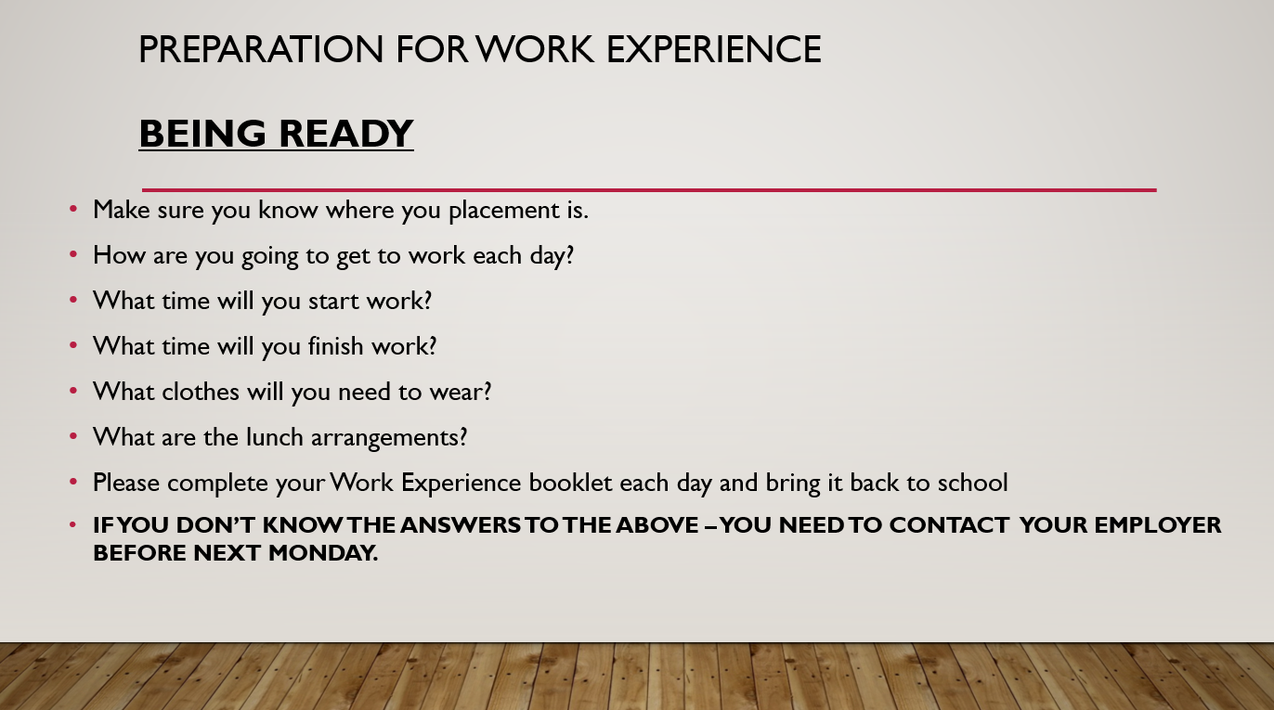
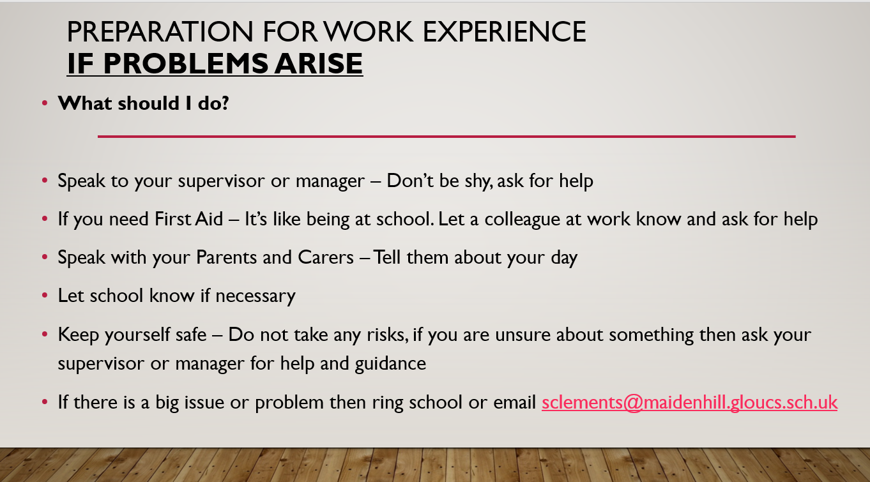
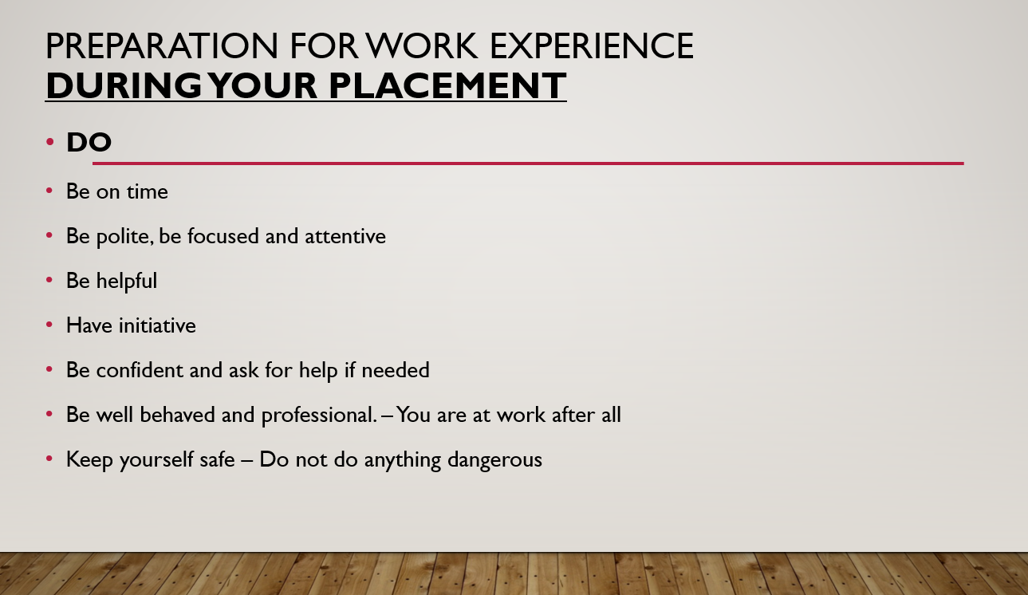
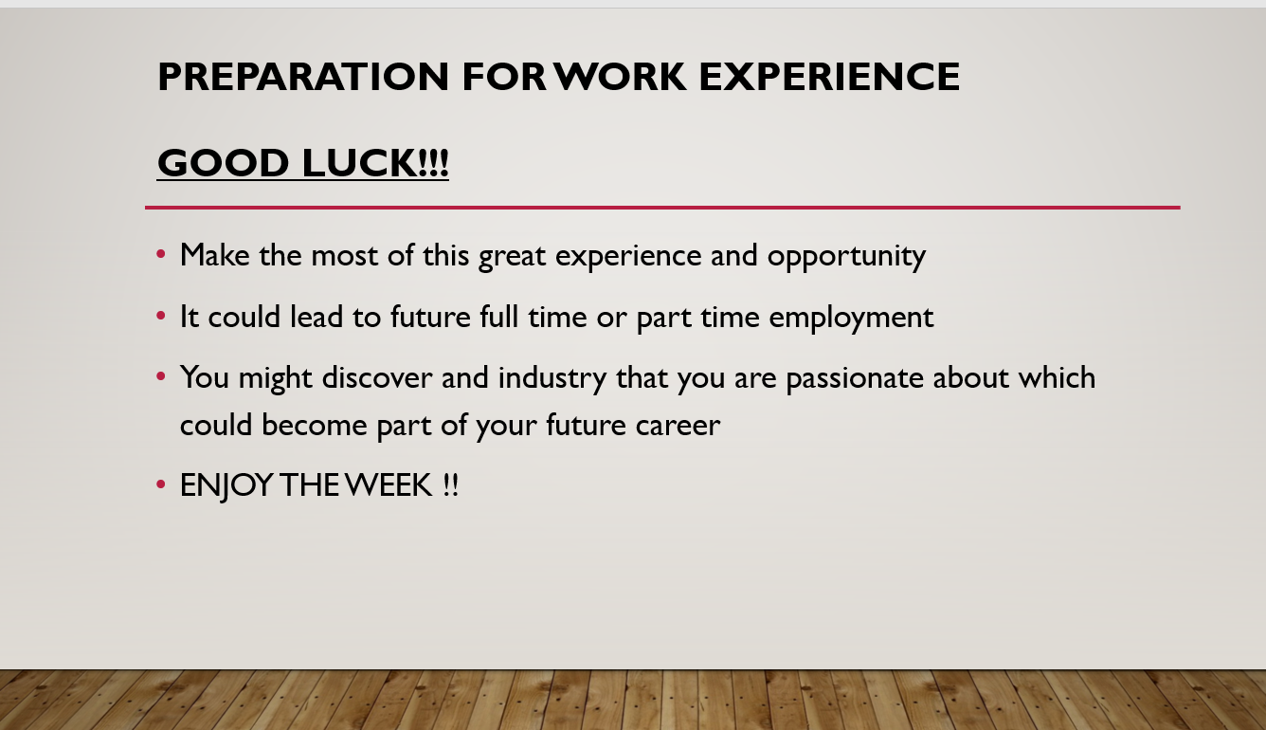
Work Experience
Work Experience

Slide 14

Reading Challenge
Reading Challenge

