Slide 1


Slide 2


Flare key messages
'Flare' is a Safer Gloucestershire app, created for women and girls, to anonymously share their experiences of how and where they’ve felt unsafe and to report incidents such as Drink spiking, verbal abuse, inappropriate touching or on street harassment.
Whilst ideally, we would want those who experience these types of crime to report to the Police, we know that a large number of incidents may go unreported.
The app helps local agencies and Police understand how and where you feel unsafe and take action.
It’s anonymous, quick, free to use and can connect you to support and advice in Gloucestershire.

Slide 3
Flare - What can you report?
Inappropriate Public Behaviour
Staring
Cat Calling/Wolf Whistling
Inappropriate gestures
Inappropriate comments
Invading personal space
Verbal Abuse
Other inappropriate public behaviour
Drink Spiking
Public Stalking Behaviours
Being followed spied on
Being given unwanted gifts
Online harassment/stalking
Being threatened repeatedly
Unwanted repeated social contact
Other stalking behaviour
Being followed spied on (Repeatedly)
Sexual Harassment/Violence
Inappropriate touching
Being sent inappropriate images
Indecent exposure
Up skirting
Serious sexual assault/rape
Other public sexual harassment

Slide 4
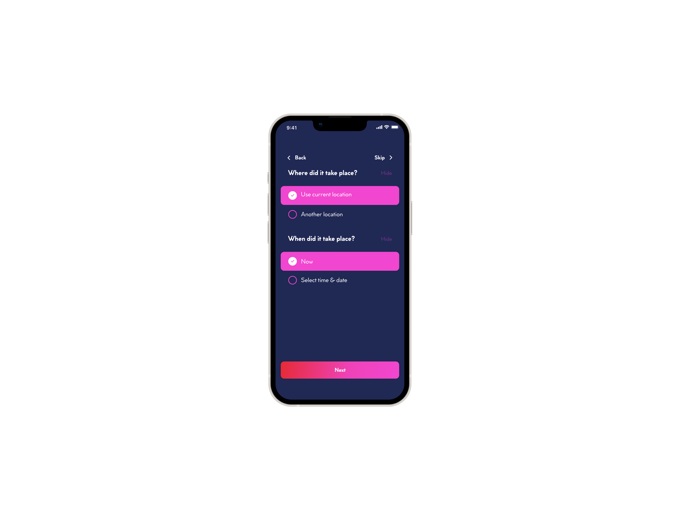
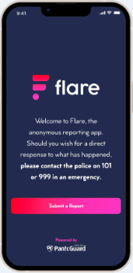
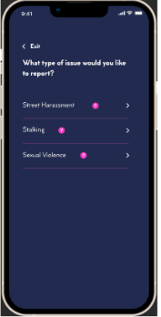
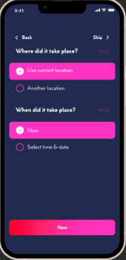
Flare App screens

Slide 5
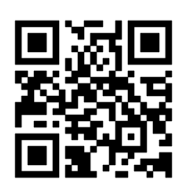
Flare - How do I download?
Flare can be downloaded from either Google Play or the Apple store
More information can be found at www.flarereport.co.uk
Alternatively, scan this QR code today!

