Slide 1
Hello! from
Young Minds Matter
(YMM)
Notes:
Hi, I’m here today to introduce to an organisation that is new to your school called YMM. We are part of the NHS and we work with children from 5 up to young people of 18 on helping them with their mental health.

Slide 2
Who are we?
We are a Mental Health Support Team
We provide support to young people (from the age of 5 to 18) with low to moderate low mood and anxiety. We also work with parents.
6-8 sessions in school.
We are part of CAMHS and also work alongside TIC+ (Counselling Service).
Notes:
Martha’s slide

Slide 3
What is mental health?
Mental health is all about our thoughts, feelings, emotions and behaviours
Looking after our mental health is just as important as looking after our physical health
Notes:
What is mental health? We really understand about looking after our physical health for example eating well & exercising regularly but we don’t think usually look after our mental health as much as we should.
Charlotte’s Slide

Slide 4
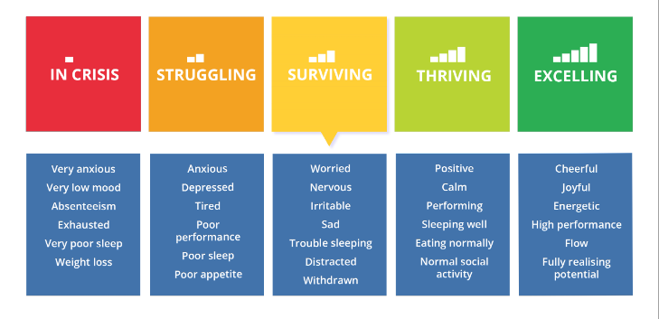
We’ve all “got” mental health all the time
Notes:
Martha’s slide
We’ve all got mental health all of the time. At any one time we are somewhere on this scale between in crisis or excelling. Our mental health at any one time is effected by biological factors (such as our brain chemisty), life experiences & family history. If you are surviving, struggling or in crisis there is help available. If you are thriving or excelling it is still important to keep looking after your mental health

Slide 5
What can we help with?
Low Mood
Social Anxiety
OCD (Less than an hour impact a day)
Panic
Generalised
Anxiety
Separation
Anxiety
Phobia (Not sick or needles)
Notes:
So.. We have talked a lot about anxiety and this is something that we can support you with. However we can also support you if you are feeling low etc

Slide 6
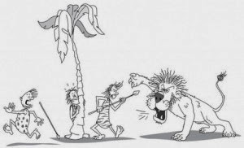
What can YMM help with?
Anxiety
Fight
Freeze
Flight
Notes:
Martha’s slide
So what is anxiety. Experiencing worry is normal & it keeps us safe…who has heard of our fight, flight or freeze response. We still have that response it is like an alarm that makes our body react in response to danger. Our body gets ready for flight, fight or freeze physically. Take a minute to imagine that you are one of these early humans and you’ve just seen the lion. How does your body react? We are all different.

Slide 7
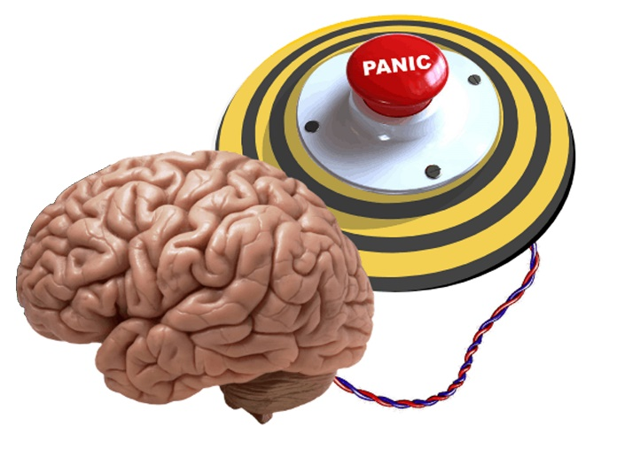
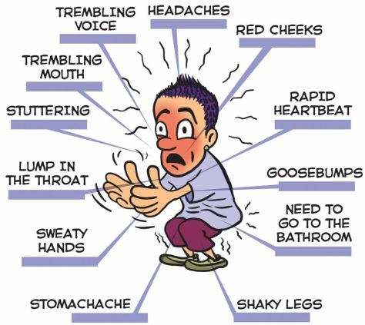
Anxiety
Notes:
Here are some common body sensations that you are feeling worried. As humans we still have that alarm in our brains that make us react like this even if we aren’t in danger of being eaten by a lion. Your brain doesn’t know the difference between a lion and going to a lesson you’re worried about.
Charlotte’s slide

Slide 8
Anxiety
Separation anxiety
Social anxiety
Phobias
Generalised anxiety
OCD (< 1 hour/day)
Notes:
Martha’s slide
If you worries are starting to impact on how you live your life for example if you are avoiding doing things it is time to get help. There are many different types of anxiety. These are the main ones we work with.

Slide 9
What makes us feel anxious?
Friendship problems
Being liked
Doing well in school
Exams
Fitting in
Putting hands up in class
Talking to adults
The war
Covid
Family
Death/dying
Germs
Being late
Getting lost
Forgetting something
Getting into trouble

Slide 10
School Based Anxiety
It is very normal to feel worried about coming into school because of lots of different reasons
Things in school:
Friends, school work, exams, finding lessons hard
Things outside of school:
Bereavement, illness, being a young carer, relationship breakdowns
Finding the school environment anxiety provoking and exhausting

Slide 11
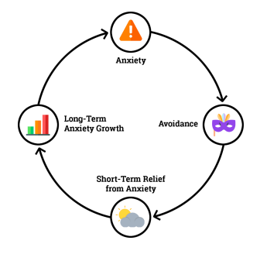
School Based Anxiety
What does school based anxiety look like?
Not wanting to get up and get ready
Saying they can’t go
Worrying about small issues such as having the right equipment for a lesson
Feeling sick or having stomach or head aches
Not sleeping very well
Not doing school works, or grades start to drop
Being angry or upset or acting out at home or school
Withdrawing
Notes:
We use what is called an anxiety cycle to show how anxiety can be maintained
When you feel anxious you may avoid a situation or look for reassurance which makes you feel better in the short term, however this maintains the anxiety in the long term as you are not allowing yourself the opportunity to learn that it will be better than you anticipate, so next time you come across that worry you want to escape again

Slide 12
Depression/ Low Mood
Feeling tired
Feeling angry/irritable
Doing less
Sleeping more
Socialising less
Notes:
Depression or feeling low can be caused by any combination of stressful or upsetting events in your life, your personality, your family history, loneliness, alcohol and drugs & illness. If you are feeling sad, low depressed you may be experiencing one or more of these things.
Charlotte’s slide

Slide 13
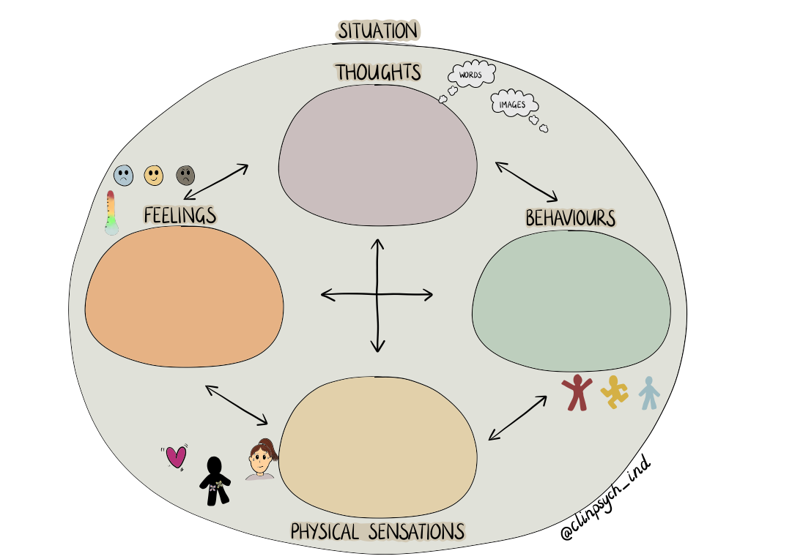
How do we help?
Rugby game- missed a tackle
Im not good enough, I should do better, should I continue playing
Withdraw, look down, not talk to team mates and lose motivation
Annoyed, frustrated and low
Sick, tired, hot and sweaty
Notes:
Martha’s slide

Slide 14
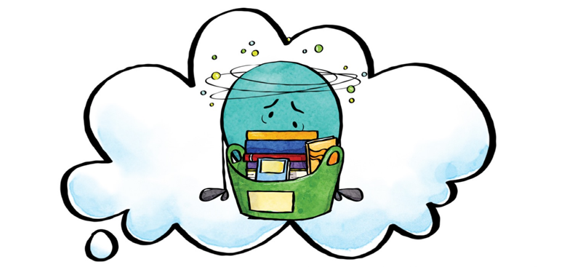
Managing emotions
We are going to share some strategies that can help your child
Notes:
Martha’s slide

Slide 15
Thought Challenging with positive self talk
I cant do it…..
I’m rubbish….
I’m going to fail….
I’m not going to make friends….
Notes:
Charlotte’s slide

Slide 16
Notes:
Now we know what worry looks like – what can we do to manage our worries?
The tips on the slide give some ideas of what things you can do to feel more relax or calm, some of these may not wor for you but it is important to give them all a try to see which work best for you – this can be done on your own, or maybe with your family or friends

Slide 17
5 senses
Notes:
Charlotte’s slide

Slide 20
D I S T R A C T I O N S
Go for a walk
Watching tv
Self care- pampering
Cooking your favourite pot noddle
Stay contacted to others
Talking to an adult
Hitting up the gym
Read a book, draw something
Notes:
Martha’s slide

Slide 21
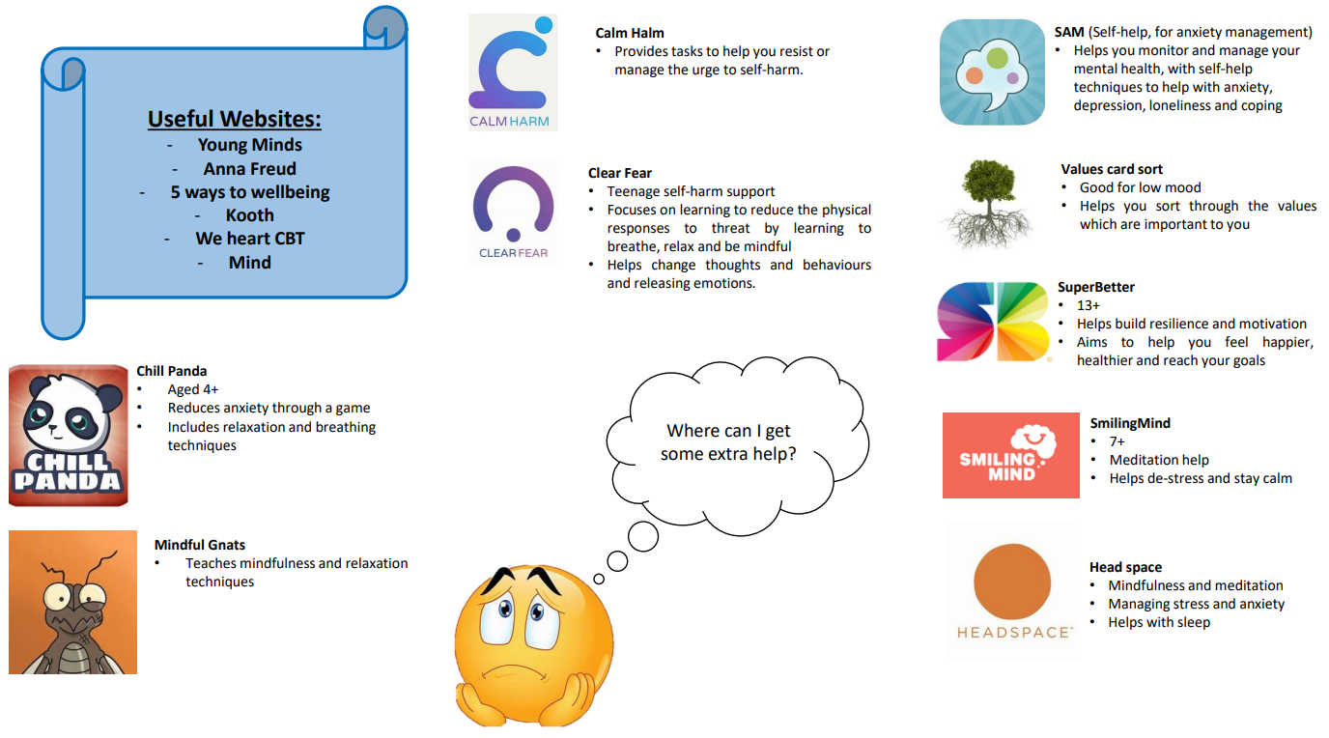
Apps
Notes:
Here are some useful websites and apps that you can also get support and advice from

Slide 22
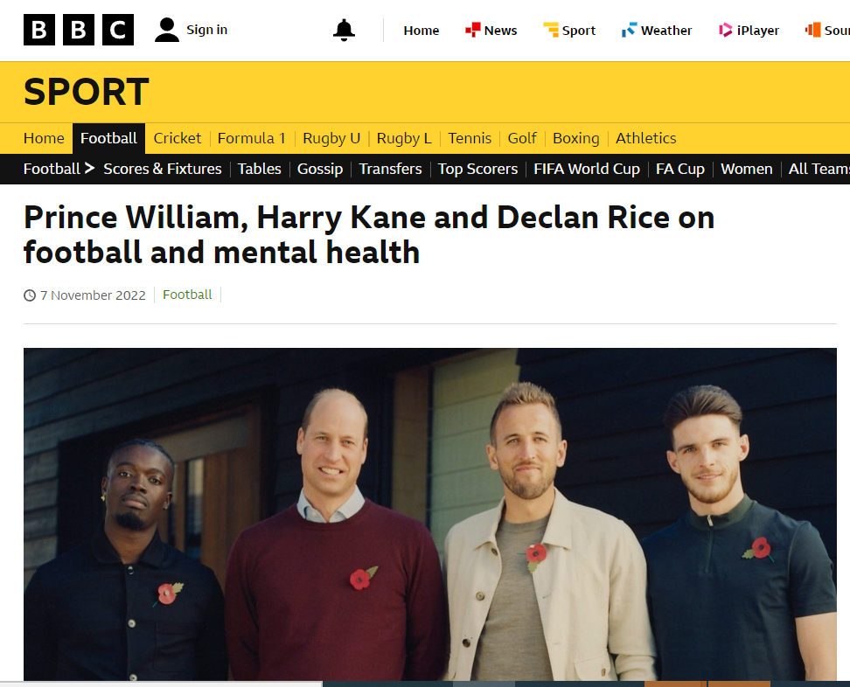
Notes:
You are never alone. There are amazing on-line services some of which are 24 hours/7 days a week. Often you can message or ‘phone or video chat. Whichever you are most comfortable with. Some of the best known of these services were publicised by Harry Kane when he launched his new mental health foundation. Here are some other mental health organisations that you could look at /turn to. They are also on Harry Kane’s Foundation website.

Slide 23
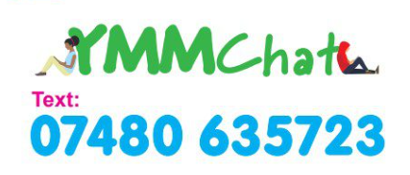
Other ways to get support:
Speak to you as their parent/carer
Trusted adult(s)
Friends
School nurse
YMM’s self-referral or YMM Chat service
Notes:
Charlotte’s slide

Slide 24
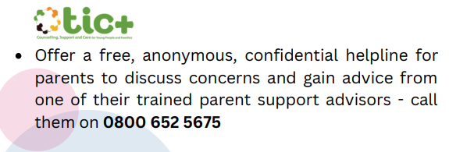
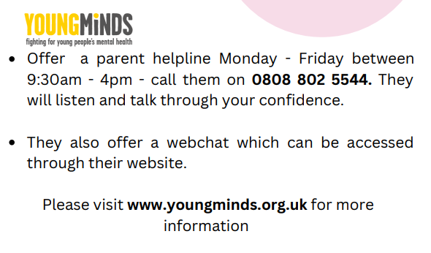
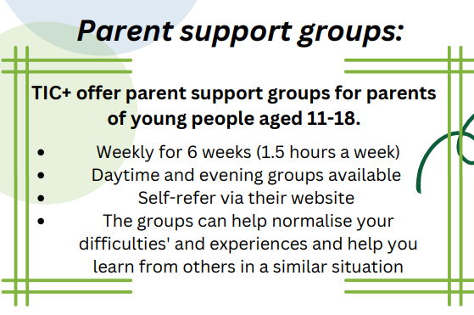
Support for you as parents/carers

Slide 25
Thank you for listening!
Any questions?
Notes:
Martha

